Slide 1
Algorithmic Effects on the Diversity of Consumption on Spotify
Ashton A., Lucas M., Rishabh M., Ian A., Mounia L.
University of Toronto & Spotify
WWW ‘20
Notes:
Good Afternoon everyone I am Shivangi Bithel, today I am going to present a paper Algorithmic effects on the diversity of consumption on Spotify

Slide 2
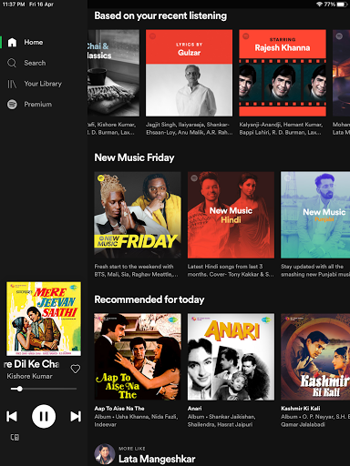
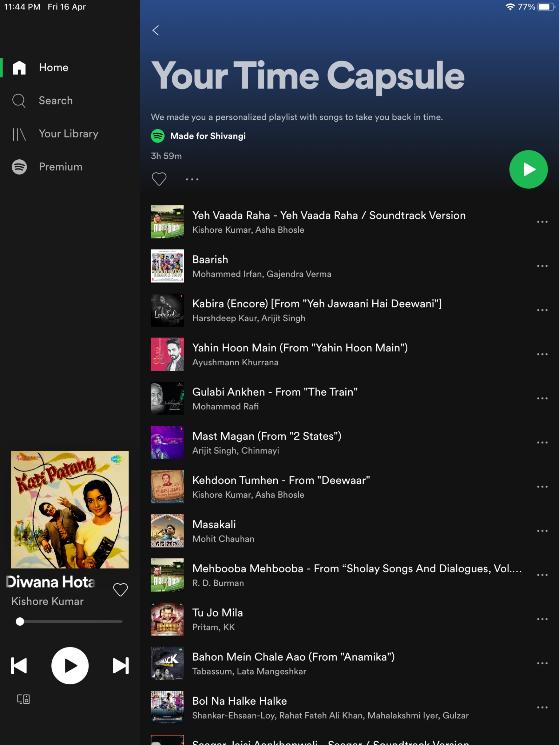
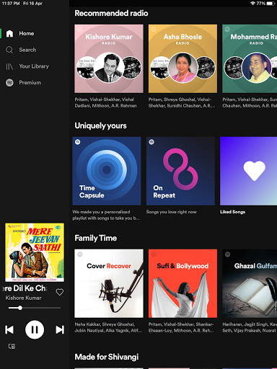
Spotify Recommendations
Notes:
For a little introduction about spotify, It is a popular online music, podcast and video streaming service that gives access to millions of songs and other content from creators all over the world. It was recently launched in India and thus have limited service as compared to what it provides to its users in America. It provides some free services like personalized recommendations and building playlists. With the premium account, we can have better music quality and download songs for offline listening without ad breaks. In these pictures, you can observe different labels like “Based on your recent listening”, “Recommended for today”, “your time capsule: your personalized playlist”, “Recommended radio” and “Made for shivangi”. With these different labels, spotify shows the recommended playlists to its user on homepage.

Slide 3
Research Focus & Contribution
Analysis of diversity in user behaviour in recommender systems and online platforms
Study of music listening and streaming services
Study of trade off between short-term and long-term engagement in online platforms
Notes:
In this paper, the author particularly concentrates on three research areas:
Analysis of diversity in user behaviour in recommender systems and online platforms
Study of music listening and streaming services
Study of trade off between short-term and long-term engagement in online platforms

Slide 4
Some Related Knowledge
Filter Bubble: A filter bubble is a state of intellectual isolation that can result from personalized searches when a website algorithm selectively guesses what information a user would like to see based on information about the user, such as location, past click-behavior and search history.
Diversity: In this paper, Diversity is referred to as how similar a piece of music is to the type of music the user has historically streamed
It can facilitate exploration by helping users discover new content or inculcate new tastes.
It can help the platform spread consumption across artists and facilitate consumption of less popular content.
Notes:
A filter bubble is a state of intellectual isolation that can result from personalized searches when a website algorithm selectively guesses what information a user would like to see based on information about the user, such as location, past click-behavior and search history. Filter bubble is considered as dangerous as you only see what you like and you are never going to get different opinions which can make you more critical to decide better. Some researchers have studied this problem in terms of recommender system settings as well.
What does diversity mean in the context of music recommendation?
In this paper, Diversity is referred to as how similar a piece of music is to the type of music the user has historically streamed
It can facilitate exploration by helping users discover new content or inculcate new tastes.
It can help the platform spread consumption across artists and facilitate consumption of less popular content.

Slide 5
Data
100M distinct premium users data
Time period of data collection: 28 days of July 2018 + 28 days more for temporal analysis
Data divided into
User-driven data collection
Algorithm-driven data collection
Notes:
For this paper, the author uses proprietary dataset, which contains data of 100M distinct users over a time frame of 28 days and later for temporal analysis, they added more data for other 28 days from next year and intermediate months based on experiments. This dataset contains a classification of songs based on user selection which is also called organic in this paper and algorithmic recommendation which also called as programmed by the author.

Slide 6
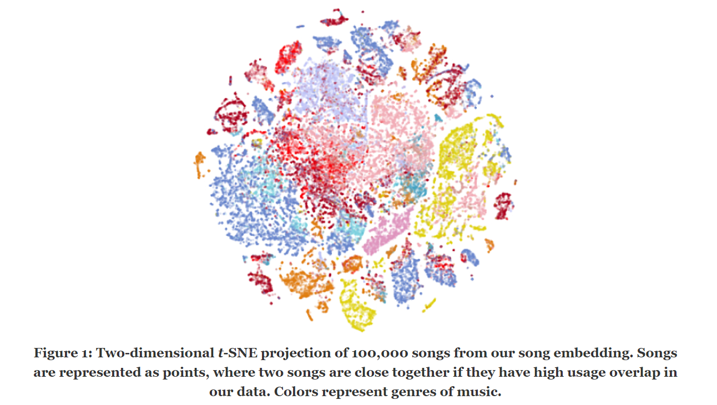
Music Embeddings
Embeddings used to encode latent representations between users and content.
Bag-of-words Word2vec model
User generated playlist - documents
Songs in the playlist- terms
850M playlists used with some filtration
User: average of the song embeddings that they listen
Vectors - 40 dimensional vectors
Cosine similarity
Notes:
To encode music content and users, in a common latent space, Spotify uses bag-of-words word2vec algorithm on user-generated playlists where playlists are treated as “documents” and the songs they contain are treated as the “terms” in those documents. They used 850M playlists and discarded those playlists which were too short to produce meaningful samples or too long to be built around a coherent theme. The user profile is defined by taking average of the song embeddings that they have listened to within the time window being considered. The vectors considered here are 40-dimensional. And the Similarity between two songs is calculated by the cosine similarity of the representation of these songs in the Music space.
Figure shows a t-SNE graph which concludes that users frequently build genre-themed playlists. Songs in the same genre will tend to appear close to each other.

Slide 7
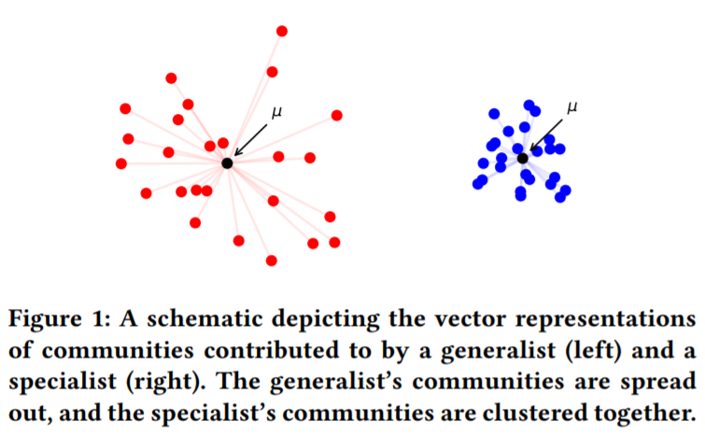
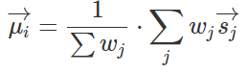
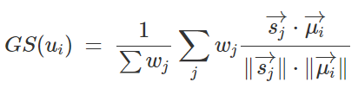
Generalist - Specialist Score
Used to quantify musical diversity of user
Specialist - if listens to very similar songs
Generalist - if listens to a diverse set of songs
GS-score measures the average cosine similarity between a song vector and the average of the user's song vectors.
Notes:
Generalist -Specialist score is another work by one of the author which is used here to quantify the musical diversity of users. Other related work to this are Gini Coefficient and entropy. These two behave similarly to GS score, while GS score is more intuitive in this case.
Specialist is a person who listens to very similar song, his song vectors will be close together in the space, similar to right cluster in blue.
a generalist is a person who listens to diverse set of songs and his song vectors will be spread apart in space, similar to left cluster in red. .
If a user u_{i} listens w_{j} times to song s_{j}, and let Sj with an arrow above denotes sj’s vector representation in the song embedding, Then ui’s center of mass is defined as 1 upon summation of wj multiplied by the summation of wj and sj vector
GS-score of u_{i} is defined as :1 upon summation of wj multiplied by the summation of wj and dot product of sj vector and mu_{i} vector.

Slide 8
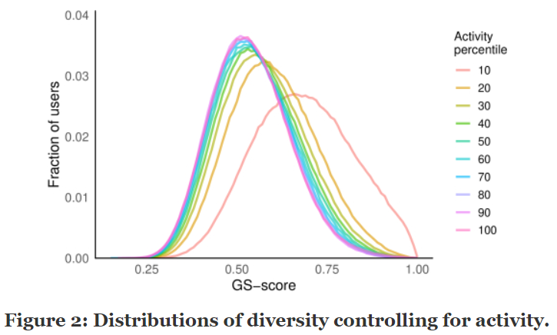
Diversity by Activity Level
Notes:
This graph shows the distribution of diversity by the level of activity. The GS score of all users available in the dataset is calculated and plotted here. The red line shows the graph of people with high GS score, centered around 0.7, which means that those people who listens to less number of tracks in the taken time frame, are tend to be specialist. We can see a broad diversity of listening diversity behaviors, ranging from extreme generalists to extreme specialists, at all levels of activity.

Slide 9
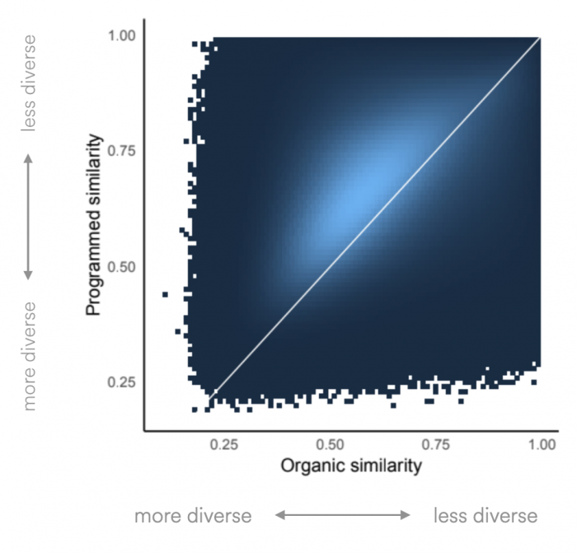
Organic
Vs
Programmed Diversity
The y = x line is shown in white. The vast majority of users are above this line, indicating that their programmed listening is less diverse than their organic listening.
Notes:
After separately computing two GS-scores for each user, one only on organic listening and another only on programmed listening, We can visualize the joint distribution of these organic and programmed GS-scores in this figure. On inspecting this, we get that user-driven listening behavior is almost always more diverse than algorithmically-driven listening behavior since most of the mass is above the y = x line.
Algorithmic recommendations support “focused” consumption more clustered together in the space, whereas organic listening is more spread out.
It could be the case that users use recommendations to satisfy their similarity-based needs and organic streaming to satisfy their exploration-based needs. It could also be that recommendation algorithms push users towards less diverse listening.
------------------- basically if we compare the length wise projection from the line x=y, we can see that for less gs score this projection height is less telling that number of people with more diversity in organic similarity are less while they are comparatively larger in case of programmed similarity as the projection hight is longer here.

Slide 10
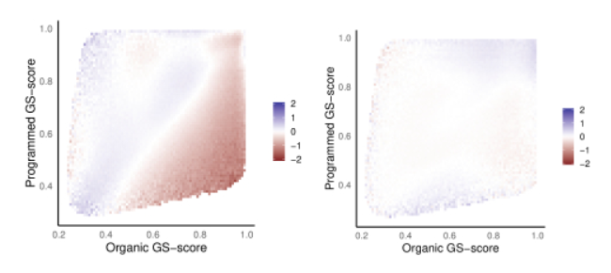
Demographic variation in Musical Diversity
Log odds ratios of diversity distributions for (a) younger and older users and (b) male and female users.
Notes:
To answer, How the listening diversity vary with demographic attributes, the author connected the organic and programmed GS-scores with self-reported age and gender.
Figure a shows the visualization between users having age 18-24 as young and represented here with blue colour and 45+ as older users represented here with red colour. The pattern is very apparent i.e. as age increases, organic diversity goes down and programmed diversity goes up. We are taking log odds ratio here for comparison, which is making this effect very practically significant, with log odds ratios ranging up to 2 (corresponding to one probability being 7 times higher than the other).
Figure b is computed using the log odds ratio of the probabilities that male users and female users have organic GS-score x and programmed GS-score y. We can see that there are no practically significant differences between the diversity of male and female users.

Slide 11
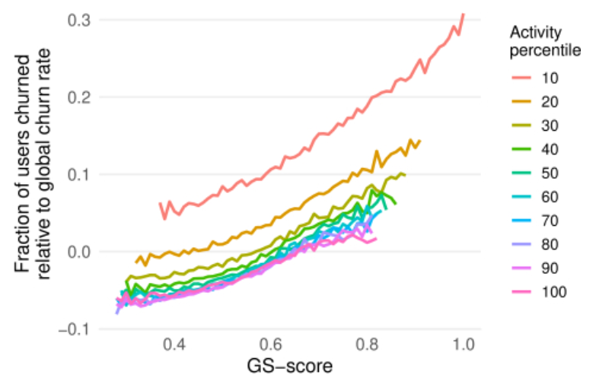
Retention: Are users remaining on the platform?
Notes:
To answer the question, do more diverse or less diverse listeners tend to stay on the platform for longer?, Author plotted a graph between GS score of a premium user vs their probability of staying an active premium user 1 year later as well. They used the global baseline average churn rate and reported all figures relative to this average . From the figure, we can see that at every activity level, generalist users are much more likely to remain on Spotify than specialist users.
We can also see that at the higher activity levels, changes in the GS-score are much more associated with changes in user retention than changes in activity are, the high-activity curves start to overlap each other.
-------------------- intuitively, if a user listens to very similar songs, the GS score will tend towards 1, since choices are closer to the weighted center. Conversely, if a user is more of a generalist, then the score will tend towards -1, by the property of cosine similarity. Specialist → 1 Generalist → -1
------------ fraction of user churned ⇒ fraction of user moved out of subscribing to premium accounts.

Slide 12
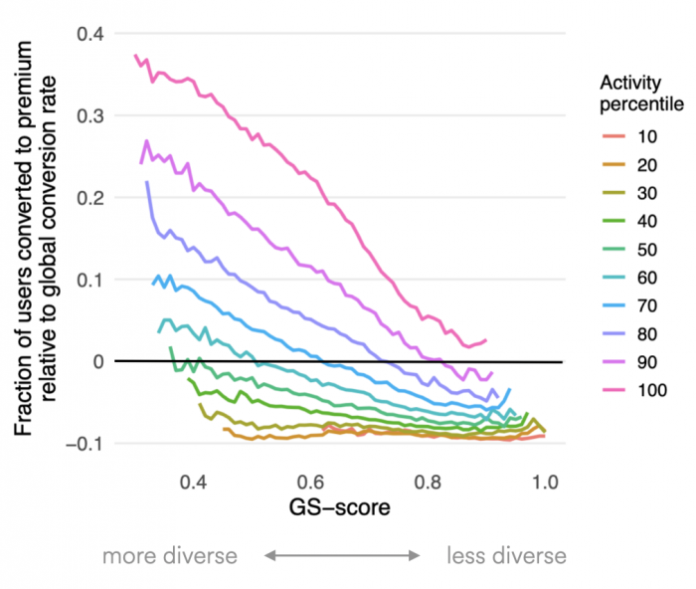
Conversion: Are generalists or specialists more likely to become premium members?
Notes:
To answer this question, Are generalists or specialists more likely to become premium members? authors collected the data of the GS-scores of spotify users which were using the app for free in july 2018 on all activity levels then measure how often these free users convert to premium as a function of their musical diversity. As can be seen in Figure, Spotify users on the free product are far more likely to convert to premium if they are generalists than if they are specialists.
low-activity users are on the whole less likely to convert into paid subscribers.

Slide 13
Conclusion 1
Conversion and retention are associated with greater content diversity.
Recommendation Algorithms of spotify, though derives a significant amount of engagement, are associated with lower content diversity.
Recommendation Algorithm can be effective in short-term while they are counterproductive in long-term.
Notes:
Conversion and retention are associated with greater content diversity.
Recommendation Algorithms of spotify, though derives a significant amount of engagement, are associated with lower content diversity.
Recommendation Algorithm can be effective in short-term while they are counterproductive in long-term.

Slide 14
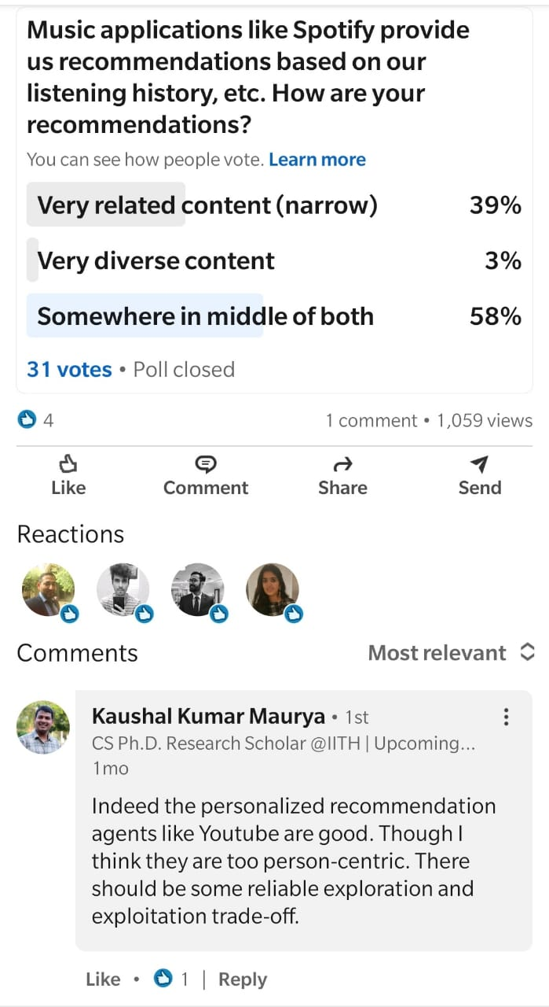
My Experiment
I created a poll after reading this paper, to know how people in my linkedin connection feel about their Spotify Recommendations
39% - Less Diverse
3% - More Diverse
58% - Mixture of both
Total people voted = 31
Total views on poll = 1059
(PS: Not an influencer yet to get more people see my post and vote)
Notes:
To prove the derived conclusion, I did a small experiment, by creating a poll on LinkedIn to know how my connections feel about their spotify recommendations. I found that 39% people feel that their spotify recommendations are narrow and they get very related content while only 3% people think that they have very diverse content on their app. Majority think that it is somewhere in the middle of narrow and diverse.

Slide 15
Musical Diversity Over Time
Activity Adjusted GS Score
For a given time period T, a user activity-adjusted GS SCore is the percentile rank of their GS SCore relative to all users in the same activity bucket at time T. This enables comparing GS Scores across time, controlling for any activity biases.
Notes:
To measure the stability of user’s musical diversity over time, Author introduces this new activity adjusted GS score to avoid activity bias over time. It is the percentile rank of GS score relative to all users in the same activity bucket at time T.

Slide 16
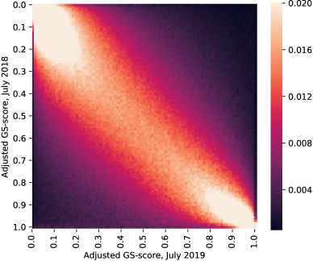
The Stability of Musical Diversity
Notes:
For this experiment, author considered premium users who streamed at least 1 track per month over the time period of an year. The adjusted GS score is plotted in this graph for each user in july 2018 and july 2019 and the observation is that most of the probability mass is concentrated on the diagonal, meaning that GS score remains stable after one year. Second observation is that extreme generalist and extreme specialist are disproportionately likely to have same musical diversity behaviour from one year to next year as we can see the concentration of mass in corners.

Slide 17
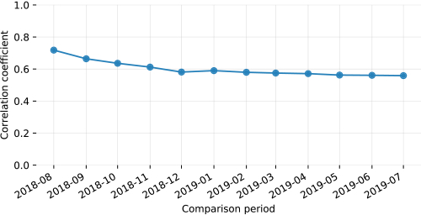
The Stability of Musical Diversity
Notes:
The previous graph plotted the time of two months at a separation of one year. But in this graph, we can see the variation over a continuous period of each month. Here author plotted the correlation coefficient between the GS score of july 2018 and each of 12 subsequent months, which is unstable initially in two three months but then stabilizes to a particular level. Thus Musical diversity is stable over long periods of time.
This also states that users initial experience on spotify is important and user should get a diversity which remains stable over time.

Slide 18
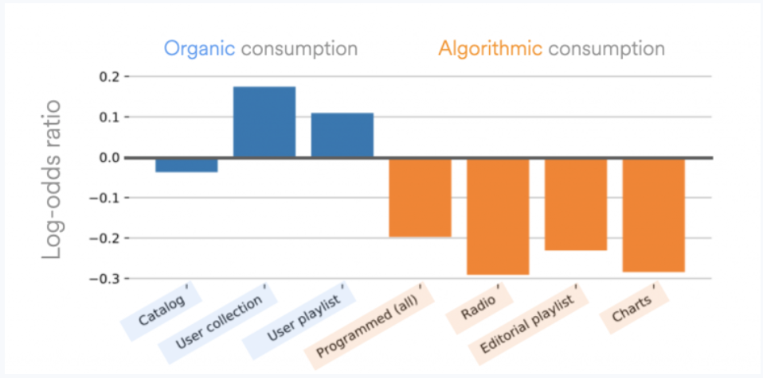
Mechanism of Change
Notes:
Some users change their diversity from specialist to generalist and vise versa, thus to know how that happened, author partitioned the users into two different set
First are those whose GS score has increased from july 2018 to july 2019
Second are those whose GS score has decreased in that time period.
This figure shows the log odds ratios of streams from users whose GS score has increased & decreased respectively against different play context like catalog, user collection, user playlist which are organic and radio, editorial, charts which are programmed.
We observe that users who become more diverse do so by curating and listening to their own library playlists, while decreasing their relative consumption of algorithmically-driven content. Programmed streaming, shown in orange, universally goes down, while organic streaming, shown in blue, almost universally goes up.

Slide 19
Conclusion 2
The GS-score is quite stable over time, clarifying that it captures an inherent behavioral characteristic of users.
On explicitly analyzing users who increased their diversity over time, author found that these changes are accompanied by increases in their organic streaming and decreases in their algorithmically-influenced consumption
Notes:
the GS-score is quite stable over time, clarifying that it captures an inherent behavioral characteristic of users.
On explicitly analyzing users who increased their diversity over time, author found that these changes are accompanied by increases in their organic streaming and decreases in their algorithmically-influenced consumption

Slide 20
Impact of Recommendations for Generalist & Specialist

Slide 21
Experimental Setup
Author Considered 7 popular algorithmic playlists
Randomly assign a ranking algorithm in these playlists
Popularity Ranker - popularity in descending order
Relevance Ranker - relevance to user
Learned Ranker - based on neural network model with user-level, song-level and interaction level features.
Online A/B Test on 5,40,000 users using free version of spotify
Notes:
For another experiment, author considered 7 popular algorithmic playlists. For different users in A/B test, ranking algorithms were randomly chosen in these playlists.
In Popularity Ranking, the songs are ranked by popularity in descending order.
In Relevance ranking, the songs are ranked by their relevance to the user.
In learned ranking, author used a neural regressor model that scores each song for a user based on their user-level, song-level and interaction level features. User-level features used are user’s country, affinity to various genres and their vector representation in song embedding. The song level features are its popularity, its genres and its vector representation. The interaction level features include the cosine similarity between the user and the song vectors and the user’s affinity to song’s main genres.
It is a five layer fully connected neural network on random sample on 6 million user-song interactions with song completion as objective. As the loss function, cross entropy loss is being used which penalize the distance between the label and the model’s output.

Slide 22
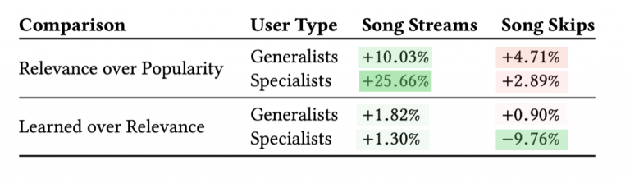
Relative Performance of Different Ranking Algorithms
Notes:
Two metrics
1 Song streams which is analogous to user satisfaction and
2. song skip which denotes that user decided to skip the song are used to compare the three ranking algorithms used in experiment.
From the table, we can observe that the personalized recommendation algorithms (“Relevance” and “Learned”) worked far better than the unpersonalized baseline (“Popularity”) for both generalists and specialists. They benefited narrow listeners much more than broad listeners and we can infer that current approaches to recommendations perform better for those with less diversity in their listening habits than for those with more diverse tastes.
As you can see the positive here in song streams is more for specialist that generalist. Also in case of learned ranker, there is a 9.8% reduction in skips. So this trained model is better at learning user preference for specialist.

Slide 23
Conclusion 3
Consumption diversity is a useful signal in understanding how users will respond to recommendations.
Classical recommendation models perform much better for specialists than for generalists.
There is a need of more diversity-aware ranking methods for Generalist users.
Author hints that there are risks to algorithmic over-specialization in online platforms, and to measuring the effectiveness of recommender systems too narrowly.
Notes:
Consumption diversity is a useful signal in understanding how users will respond to recommendations.
Classical recommendation models perform much better for specialists than for generalists.
There is a need of more diversity-aware ranking methods for Generalist users.
Author hints that there are risks to algorithmic over-specialization in online platforms, and to measuring the effectiveness of recommender systems too narrowly.

Slide 24
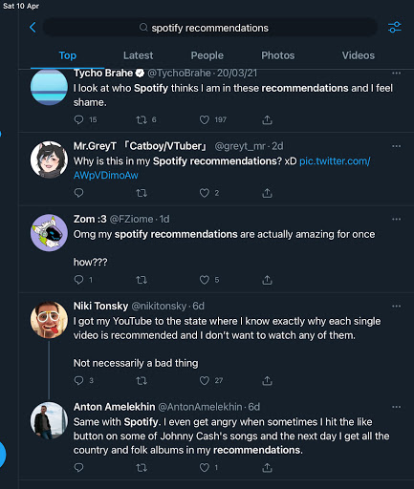
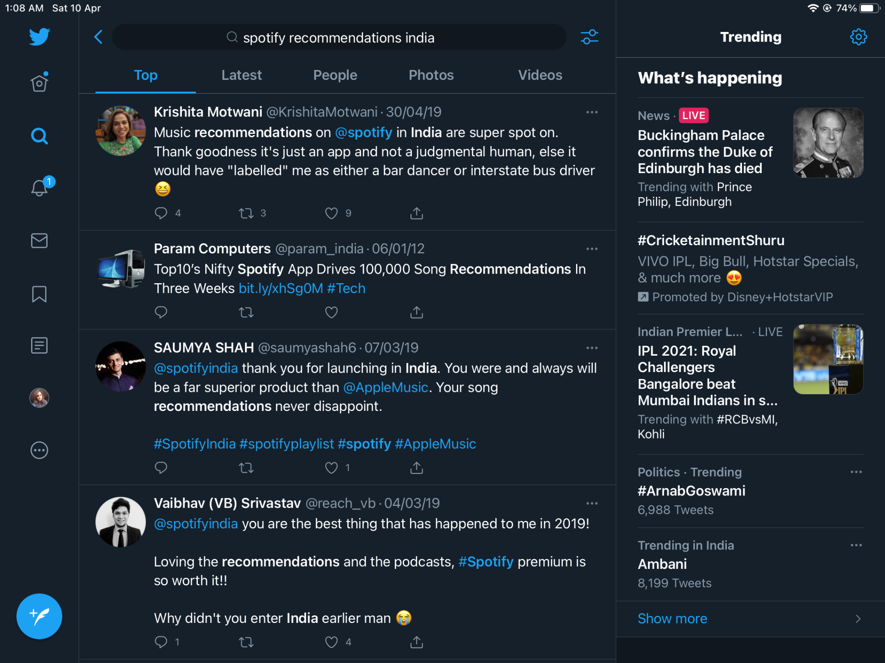
Different opinions from people on these recommendations
Notes:
I collected few tweets from twitter about people's reaction to their spotify recommendations.
Some people are confused about why they have certain song in their recommendations, while you can see some are happy about their recommendations.
Second image shows people’s reaction when Spotify was launched in India in around 2019.

Slide 25
Limitations of paper
Cold-start based recommendations
Challenges in generating and using the dataset.
Need to explore more diversity - aware algorithms.
The importance of diverse recommendations for artists and content creators.
Notes:
From my experience of spotify, when a person creates a new account, the spotify make them choose at least 5 musicians that they like and also make them choose the language like english, hindi, punjabi, bengali, etc. and this way of providing a solution to cold start problem, affects user recommendations in long term as well. I still get most recommendation after one year from the singers and language I choose initially. The author didn’t talk about this in their paper.
For capturing the data for Organic listening pattern of the user, author used the information from self created playlists. Not everyone will create their own playlist but users can also use publicly available playlists created by other fellow users of the app to increase their diversity in songs. Thus author should mention such challenges and others like these which they might have encountered while generating and using their dataset.
The author focussed more on the problem of lack of diversity in algorithmic recommendations rather than suggesting better solutions to generate diversity-aware recommendation algorithms. The one proposed solution of learning the user-level, song-level and interaction level features can be further explained and explored.
More further analysis can be done considering the importance of diverse recommendations for artists and content creators.

Slide 26
Resources
Algorithmic Effects on the Diversity of Consumption on Spotify
Generalists and Specialists: Using Community Embeddings to Quantify Activity Diversity in Online Platforms
Algorithmic Effects on the Diversity of Consumption on Spotify

Slide 27
THANK YOU :)

